Slide 1
Assignment 2
Ubiquitous Computing Lab
Suryasaradhi Balarkan 1840580

Slide 2
Problem Statement
A Gesture controlled Smart watch interface in espruino IDE

Slide 3
Solution Implemented
Implemented a smartwatch and simulated it in espruino webide
Implemented Features:
Gesture Controlled
Button Press detection
Time / date Format Control

Slide 4
Tools Used
Espruino IDE

Slide 5
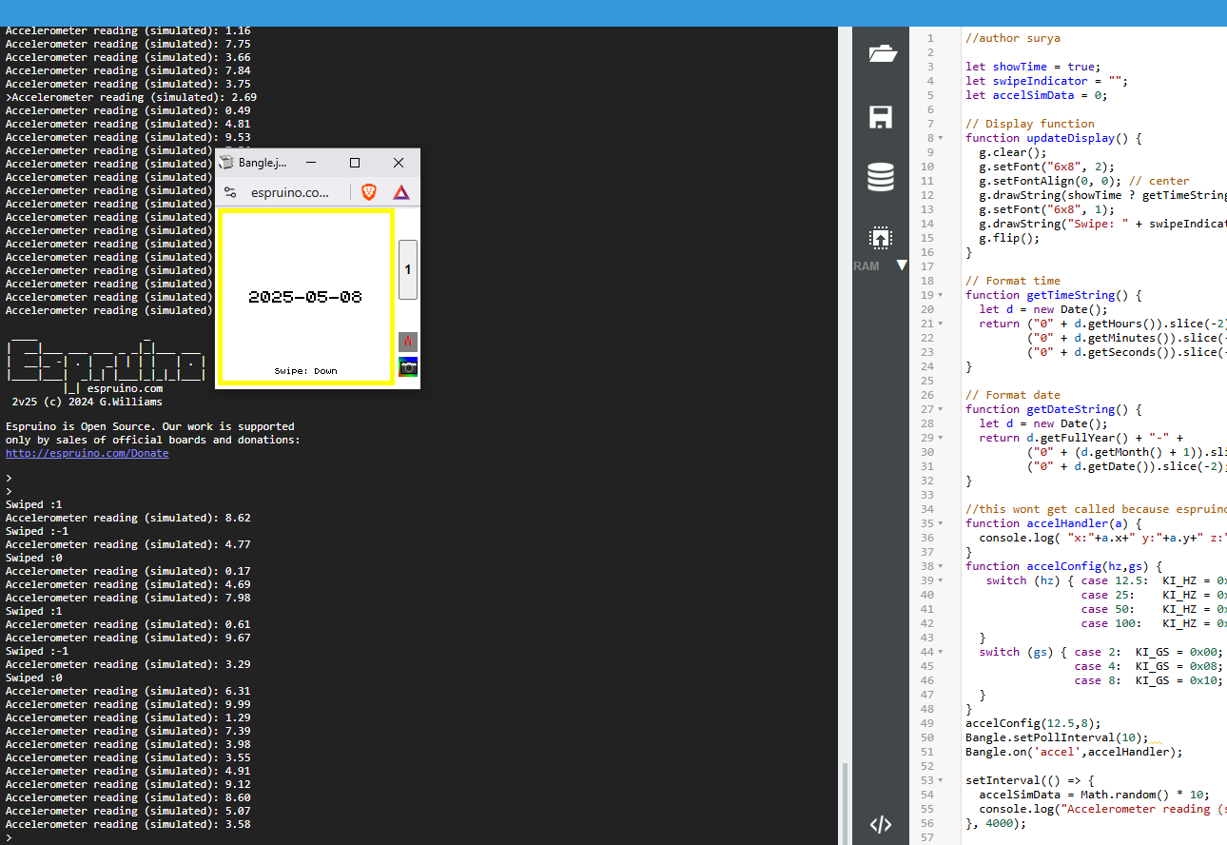
Demo :
To run the demo run
main.js

Slide 6
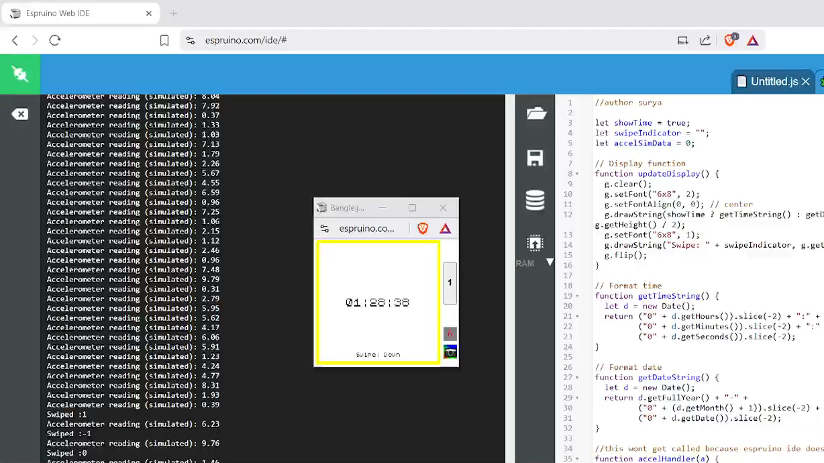
Explanation and Demo Walkthrough

Slide 7
Repository
https://github.com/thesunRider/APMWS/tree/master/assign/ubq2

Slide 8
THANK YOU

